Slide 1
MULTI-CUT-OFF REBAR
Advisor : Prof. K.C.Chang
Presenters : You-Ran Nai
Notes:
Try 講清楚脈絡

Slide 2
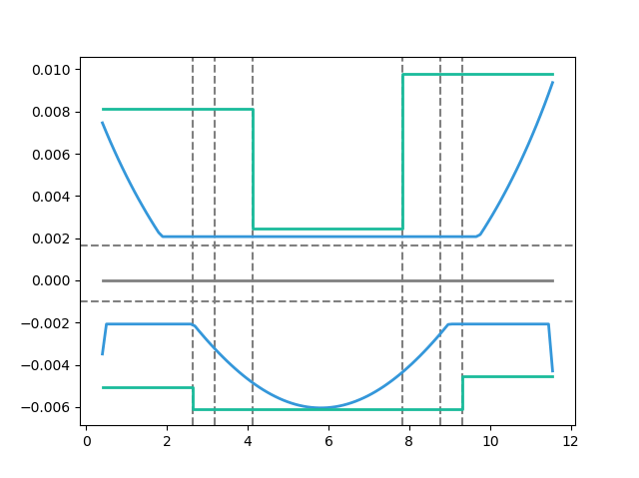
Max
Max
Today’s Solution
Bar-Cut-Off
Max

Slide 3
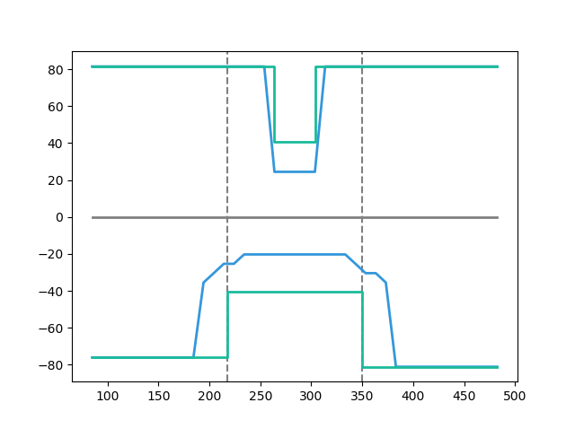
Tradition
Rebar Used
Etabs Demand
Notes:
傳統斷筋 max(ld, 1/3 span)
簡算法延伸長度比梁長還長 取最大直接配
1140

Slide 4
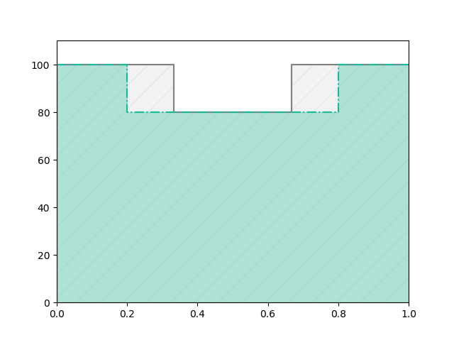
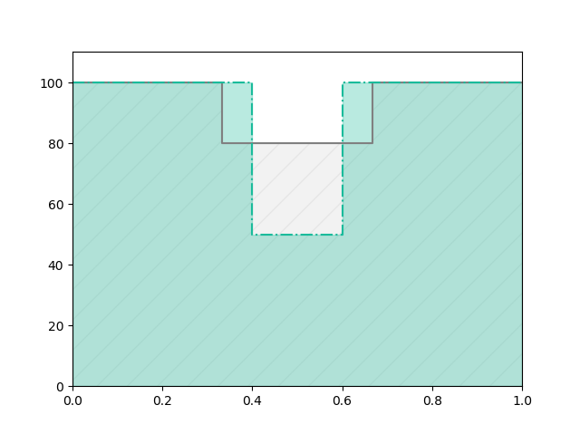
Before
After
REDUCE REBAR
Before
Real
Demand
After
Notes:
# 問題與目標
目前工程上斷筋處都固定在 1/3 或是 1/5 處
之所以這樣是為了施工上比較方便
但是這樣會有不經濟的問題產生
如果我們能做到根據需求來決定斷筋處
就能節省鋼筋的用量

Slide 5
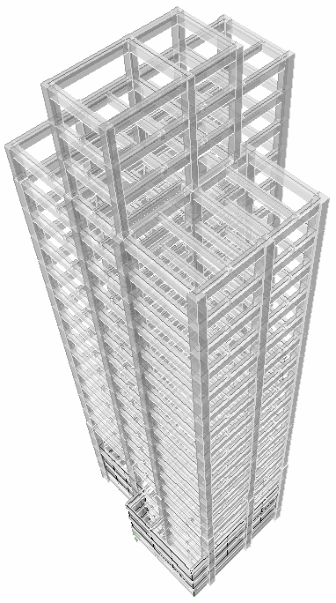
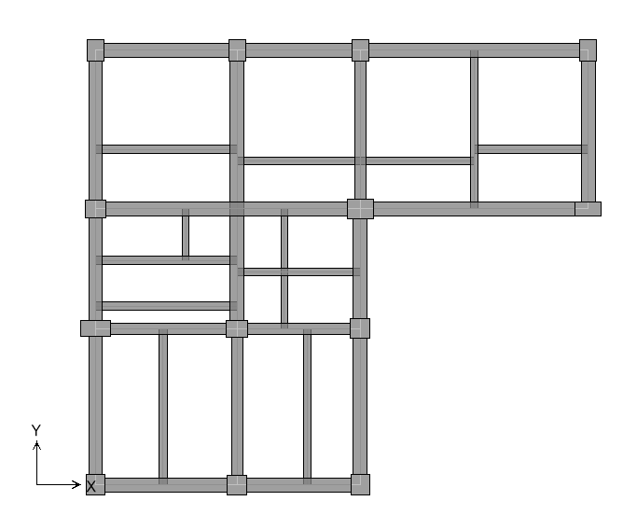
WHOLE BUILDING BEAMS
14F ONE BEAM FOR EXAMPLE

Slide 6
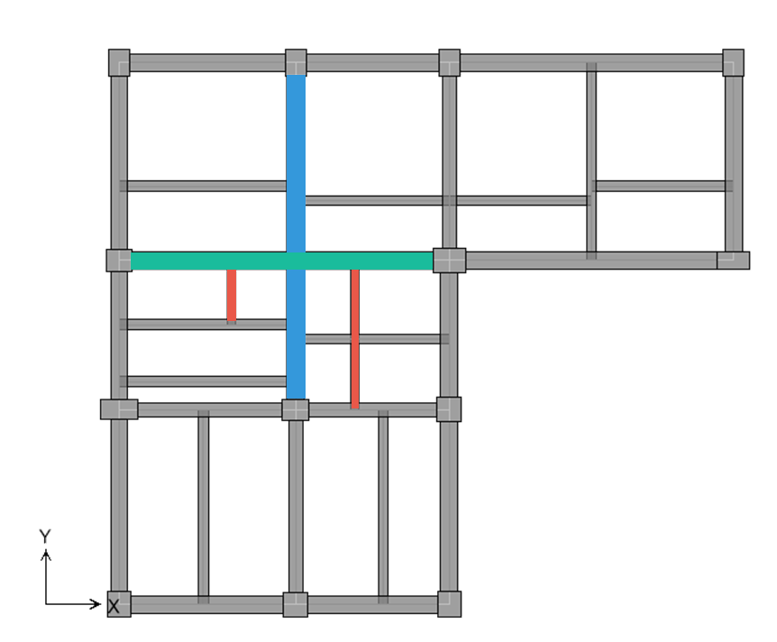
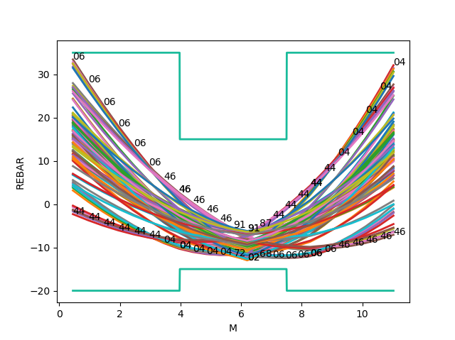
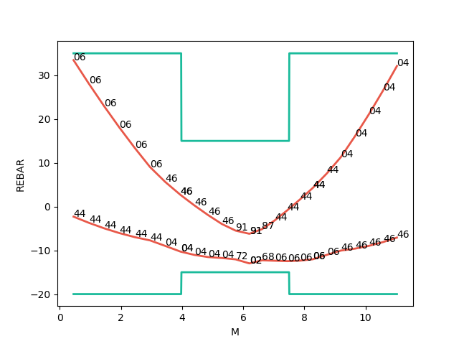
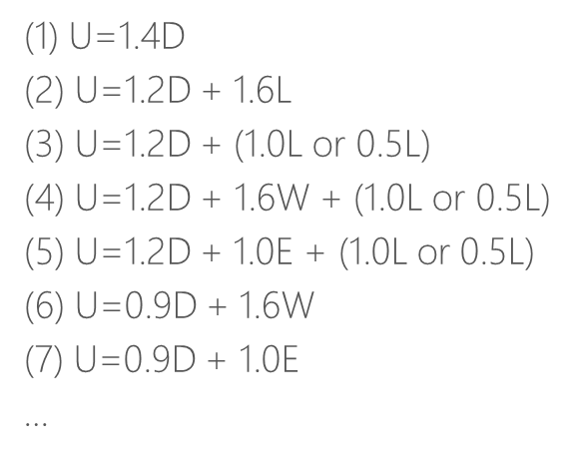
Consider Hundreds Of Combo Demand
Catch Critical Demand Combo

Slide 7
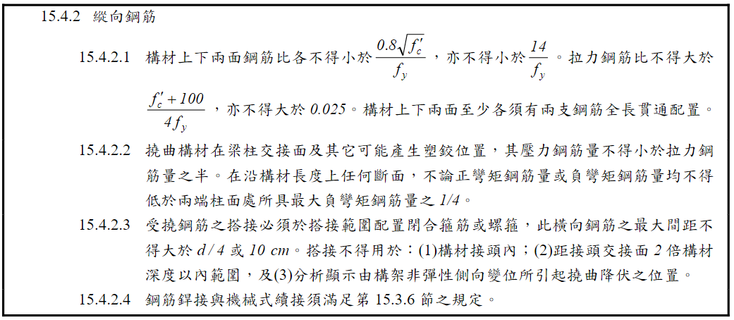
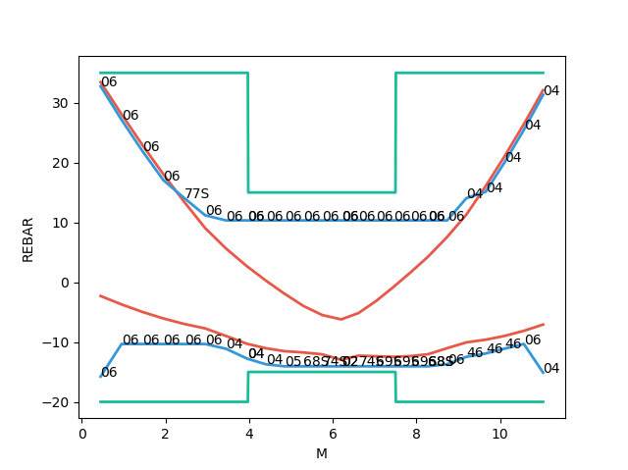
Seismic Requirement

Slide 8
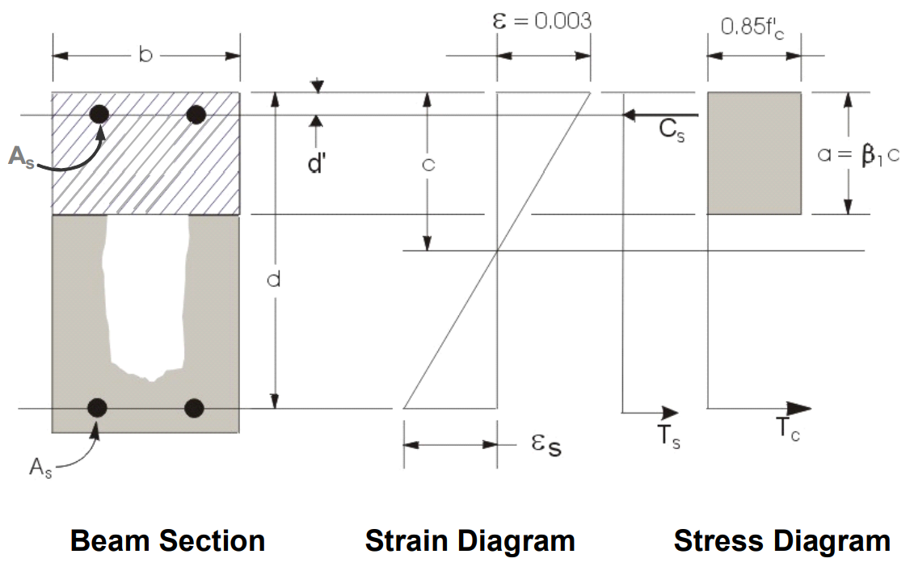
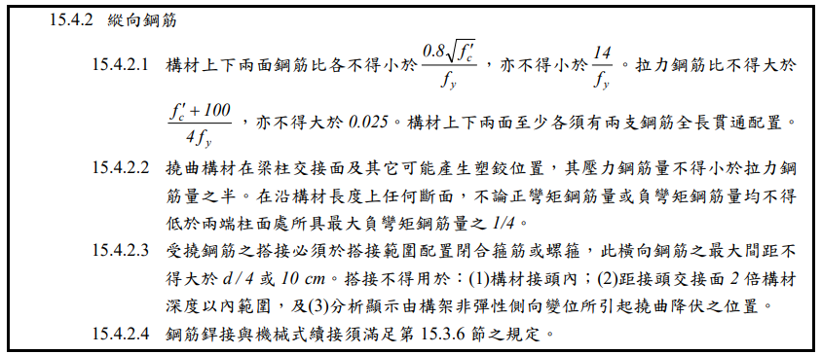
Flexural Reinforcement

Slide 9
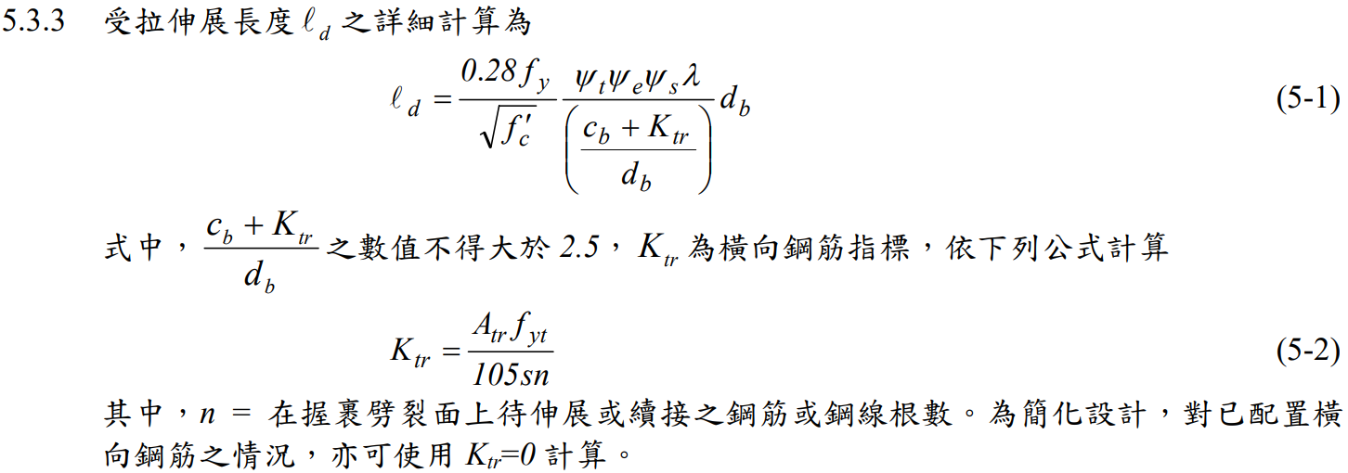
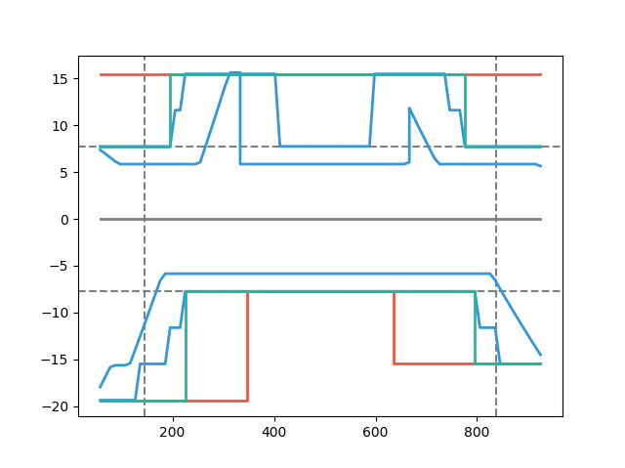
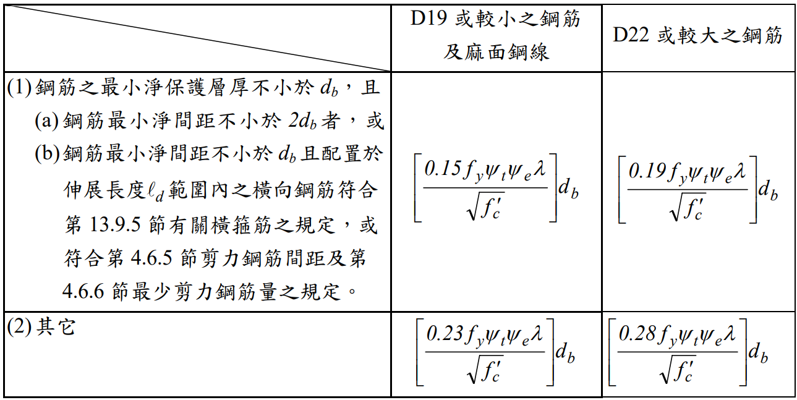
General Development Length Equation
Development Length
MIN
Simplified Provisions
Beam width, cover, Fy, Fyt, Fc’,
Rebar‘s Db, Stirrup’s Db,
Spacing, rebar number

Slide 10
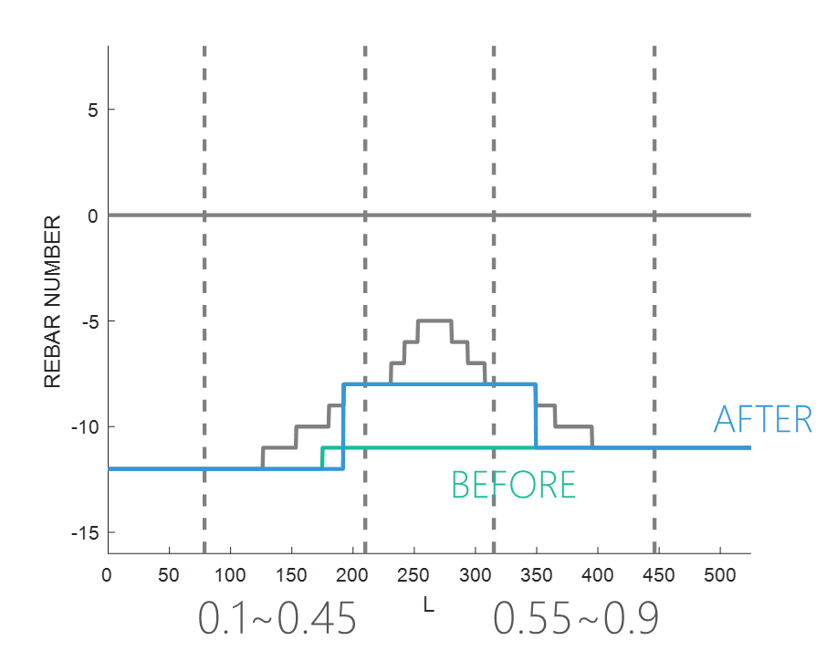
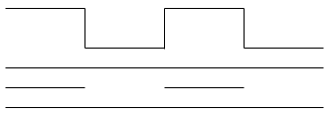
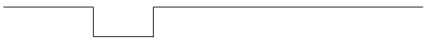
Combinations
0.1
0.9
漸進式退縮
0.1
0.45
0.55
0.9
Notes:
GA 演算法

Slide 11
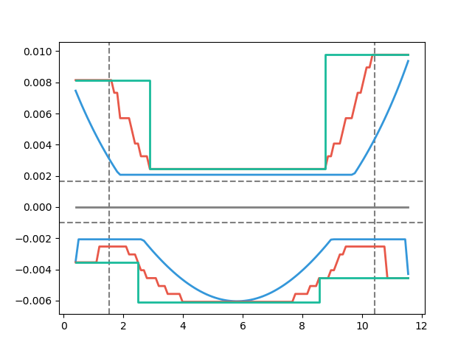
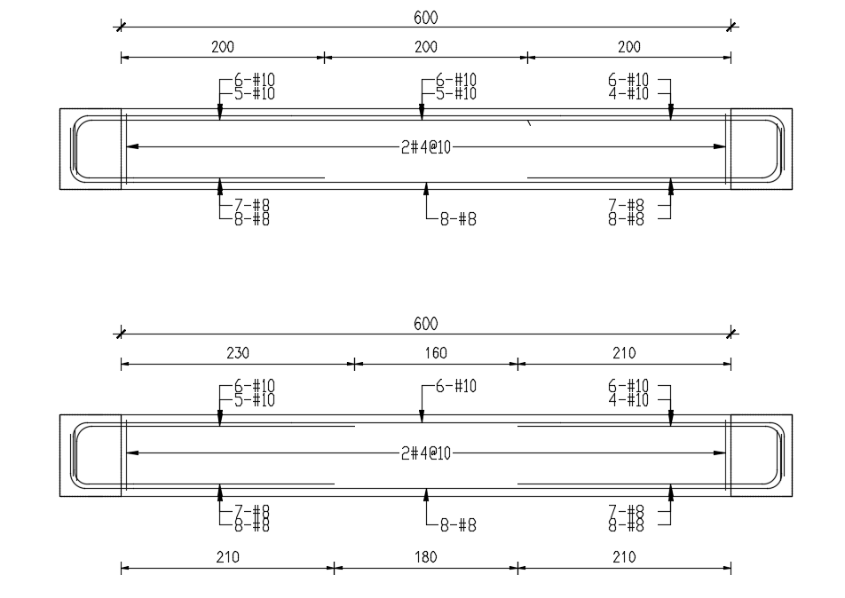

Slide 12
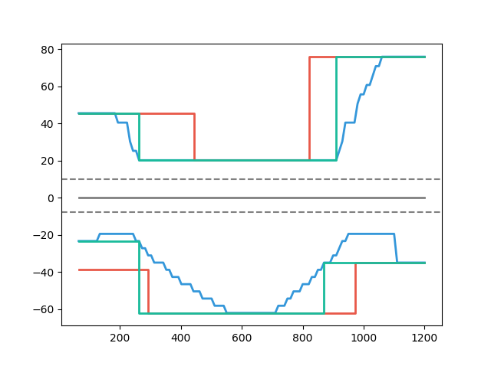
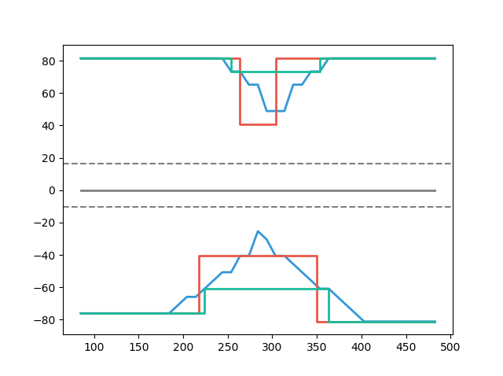
Case Study
Multi-Cut-Off 82%
Multi-Cut-Off
Tradition
Tradition
Development Length
Development Length
Multi-Cut-Off 91%
Multi-Cut-Off
Notes:
傳統不經濟
828
傳統不保守 不符合 混凝土結構設計規範 401-100 R5.11.2
1140

Slide 13
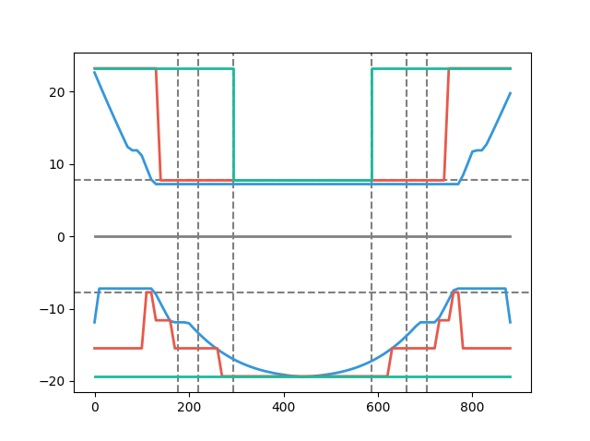
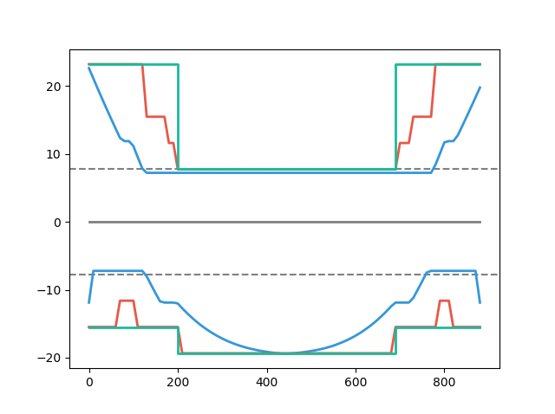
Simple Conclusion
TRADITION
SIMPLIFIED ld
MULTI CUT
REBAR USED
REBAR USED
100%
80%
ETABS DEMAND
ETABS DEMAND
EXPLICIT ld
ETABS DEMAND
ETABS DEMAND
91%
100%
REBAR USED
SIMPLIFIED ld
REBAR USED
EXPLICIT ld
Notes:
11076

Slide 14
Simplified Method
BEFORE
AFTER

Slide 15
Precondition
Lateral Force(Earthquake, Wind)
Gravity Load(Dead, Live)
Girder
Earthquake Vertical Force
Lateral Earth Pressure Ground Water Pressure Or Pressure Of Bulk Materials

Slide 16
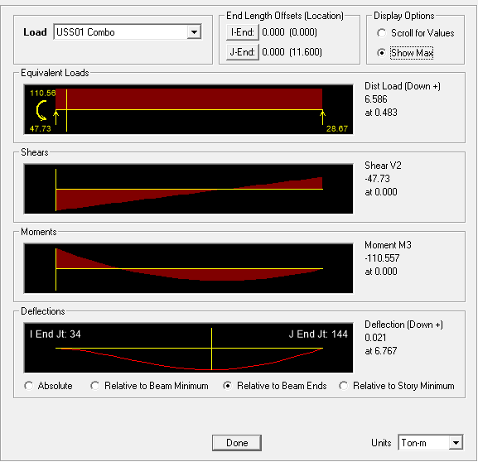

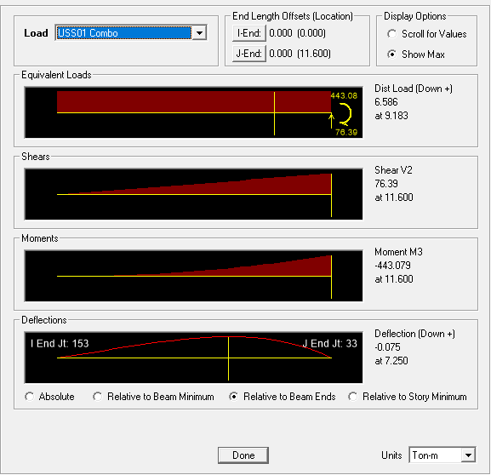

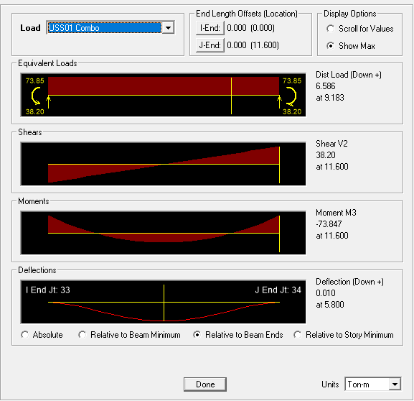

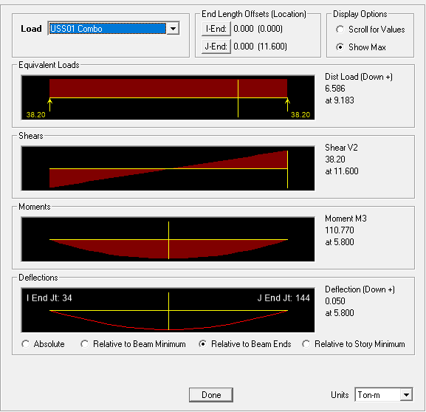

Precondition
Fix-Pin
Boundary Condition
Fix-Fix
Fix-Free
Pin-Pin

Slide 17
Top Algorithm
Initial Top Rebar
(1) U=1.4D
(2) U=1.2D + 1.6L
(3) U=1.2D + (1.0L or 0.5L)
(4) U=1.2D + 1.6W + (1.0L or 0.5L)
(5) U=1.2D + 1.0E + (1.0L or 0.5L)
(6) U=0.9D + 1.6W
(7) U=0.9D + 1.0E
Lateral
Force
Gravity Load

Slide 18
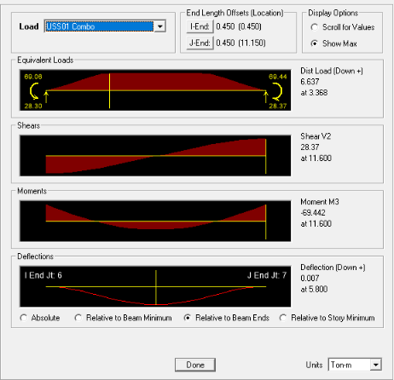
Gravity Load
94%
DL, LL, Band, Span
保守估計
(1) U=1.4D
(2) U=1.2D + 1.6L
(3) U=1.2D + (1.0L or 0.5L)
(4) U=1.2D + 1.6W + (1.0L or 0.5L)
(5) U=1.2D + 1.0E + (1.0L or 0.5L)
(6) U=0.9D + 1.6W
(7) U=0.9D + 1.0E

Slide 19
Algorithm
Change To
Rebar Number
Linear Add

Slide 20
General Development Length Equation
Development Length
MIN
Simplified Provisions
Beam width, cover, Fy, Fyt, Fc’,
Rebar‘s Db, Stirrup’s Db,
Spacing, rebar number

Slide 21
Algorithm
BEFORE
Reduce To Three Points
AFTER
Finite Combinations
0.15~0.4
Avoid Extreme Situation
0.15~0.4
0.6~0.85

Slide 22
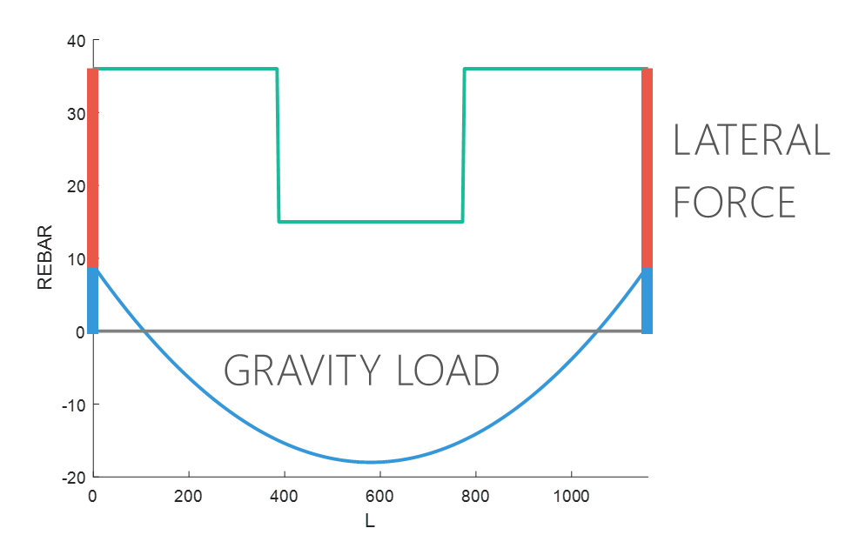
Bottom Algorithm
Different From Top
(1) U=1.4D
(2) U=1.2D + 1.6L
(3) U=1.2D + (1.0L or 0.5L)
(4) U=1.2D + 1.6W + (1.0L or 0.5L)
(5) U=1.2D + 1.0E + (1.0L or 0.5L)
(6) U=0.9D + 1.6W
(7) U=0.9D + 1.0E
Gravity Load
Lateral
Force
Initial Bot Rebar

Slide 23
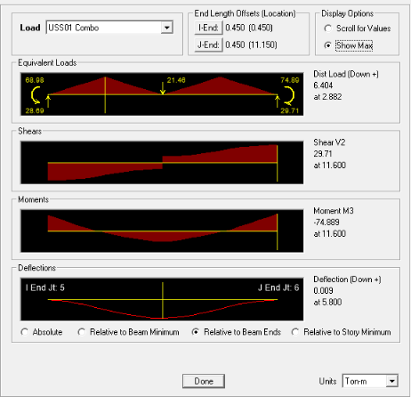
Gravity Load
DL, LL, Band, Span
保守估計
(1) U=1.4D
(2) U=1.2D + 1.6L
(3) U=1.2D + (1.0L or 0.5L)
(4) U=1.2D + 1.6W + (1.0L or 0.5L)
(5) U=1.2D + 1.0E + (1.0L or 0.5L)
(6) U=0.9D + 1.6W
(7) U=0.9D + 1.0E
119%

Slide 24
Algorithm
Linear Add
Change To
Rebar Number

Slide 25
General Development Length Equation
Development Length
MIN
Simplified Provisions
Beam width, cover, Fy, Fyt, Fc’,
Rebar‘s Db, Stirrup’s Db,
Spacing, rebar number

Slide 26
Algorithm
Reduce To Three Points
Finite Combinations
0.15~0.4
AFTER
Avoid Extreme Situation
BEFORE
0.15~0.4
0.6~0.85

Slide 27
Simplified Method
BEFORE
AFTER

Slide 28
BEFORE
=
AFTER
+
CONSTRUCTION COST ASSESSMENT

Slide 29
BEFORE
AFTER
主筋
 | 左端 | 中央 | 右端
上層 第一排 | 6-#10 | 6-#10 | 6-#10
上層 第二排 | 2-#10 | 0 | 3-#10
上層 第一排 | 0 | 0 | 0
上層 第二排 | 6-#8 | 5-#8 | 7-#8
主筋 |  |  |  | 長度
 | 左端 | 中央 | 右端 | 左端 | 中央 | 右端
上層 第一排 | 6-#10 | 5-#10 | 6-#10 | 33% | 29% | 38%
上層 第二排 | 2-#10 | 0 | 3-#10
上層 第一排 | 0 | 0 | 0 | 19% | 57% | 24%
上層 第二排 | 6-#8 | 5-#8 | 7-#8
98%
90%
93%
94%
67%
86%

Slide 30
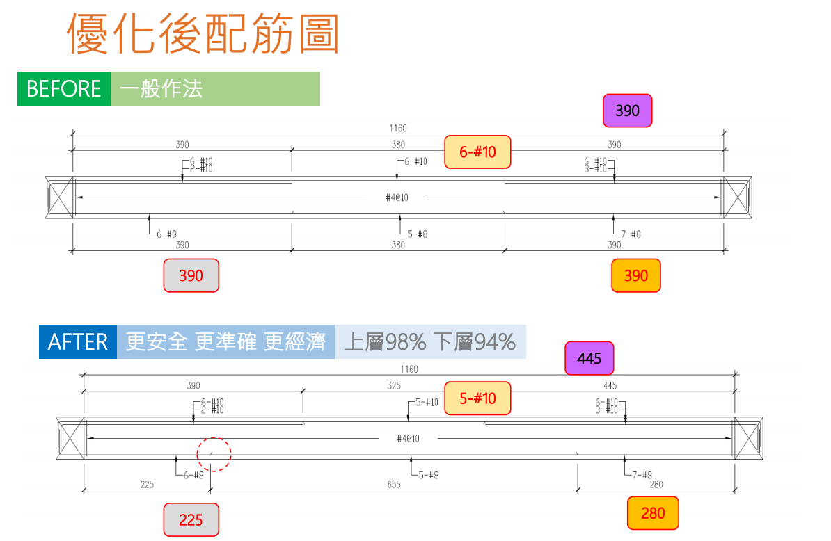
RCAD

Slide 31


Slide 32
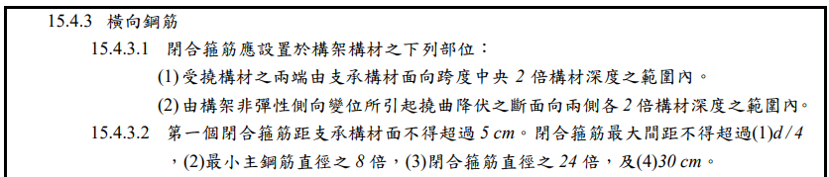
Shear Reinforcement
$$V_{u}=V_{p}+V_{D+L}$$
>2h, Consider Vc
$$V_{p}=max⁡(V_{p1}=\frac{M_{I}^{−}+M_{J}^{+}}{L},V_{p2}=\frac{M_{I}^{−}+M_{J}^{+}}{L})$$
Combinations
2h
2h

Slide 33
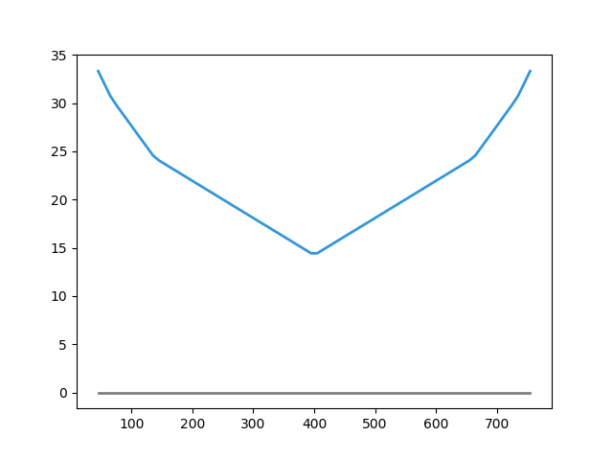
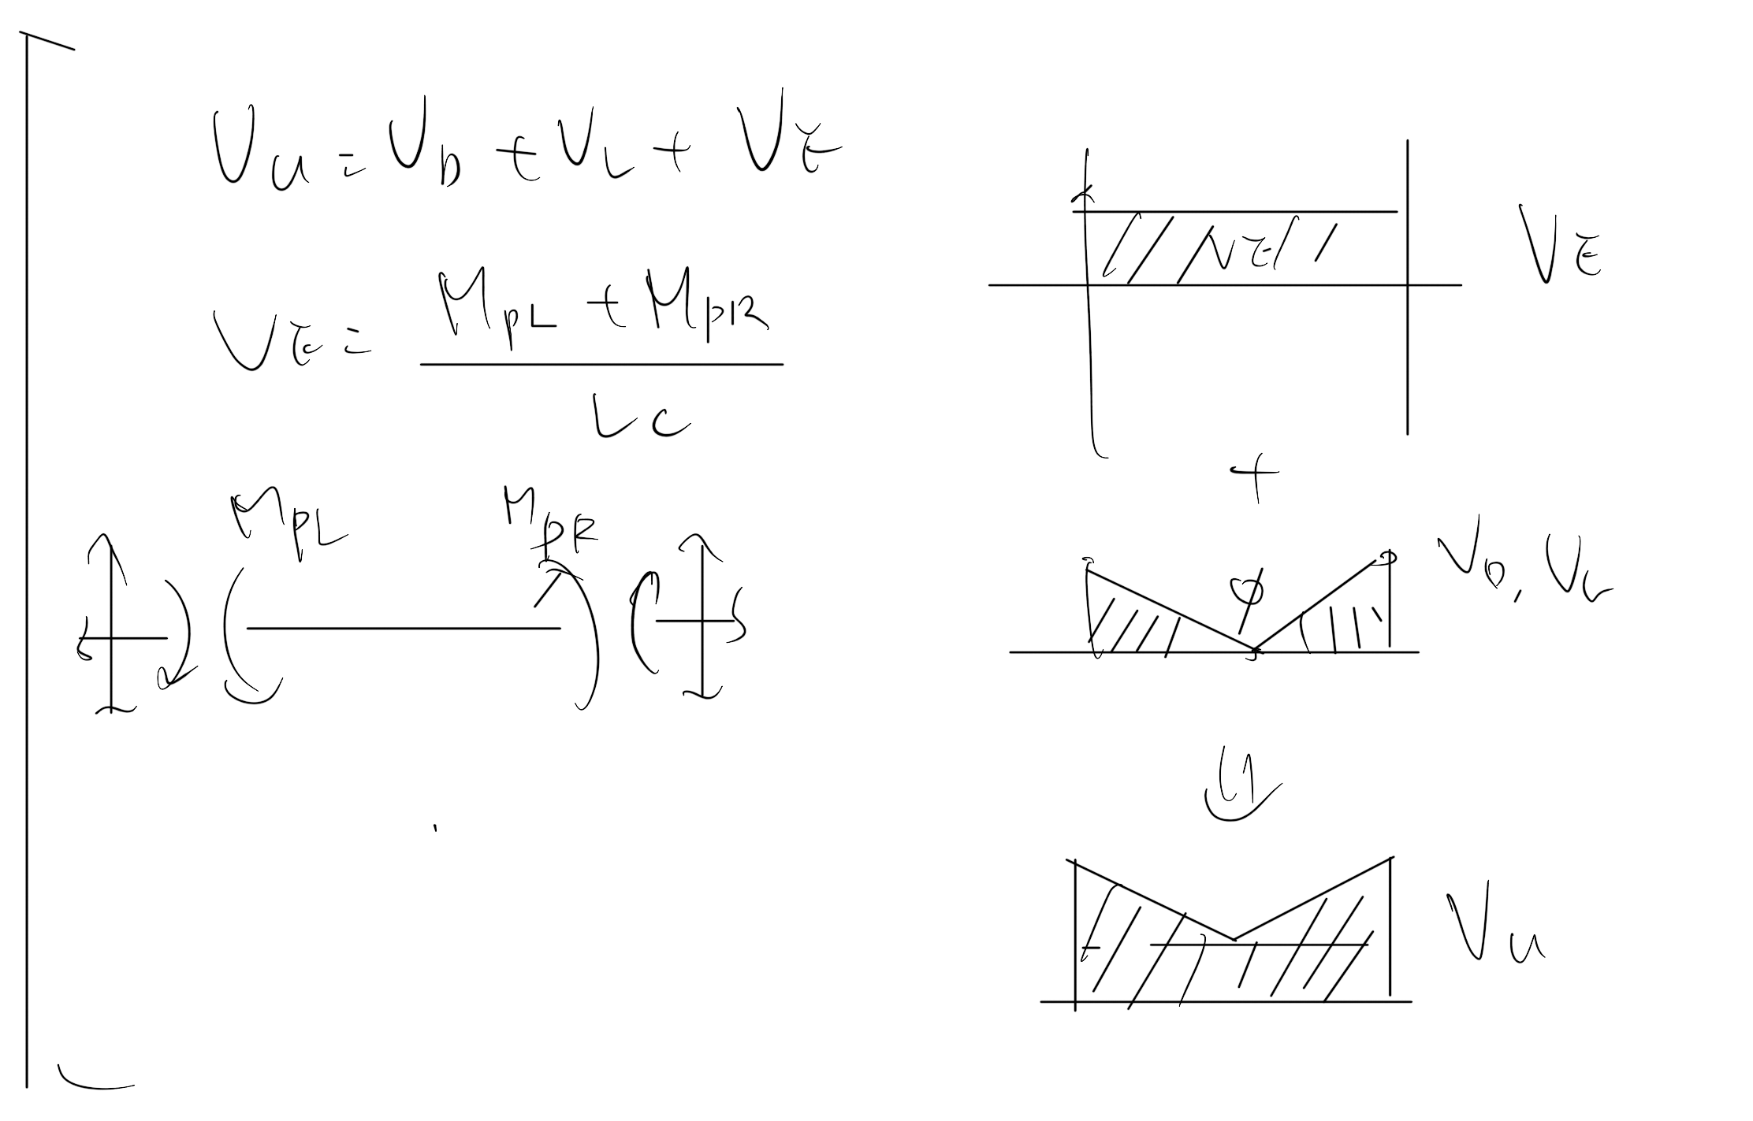
Shear Design
Easbs Shear Rebar Area

Slide 34
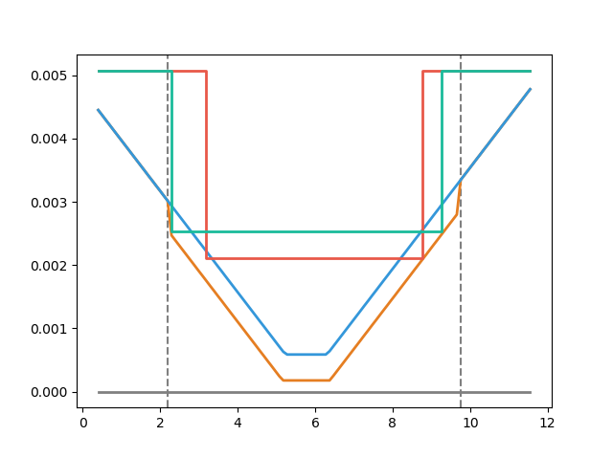

Slide 35
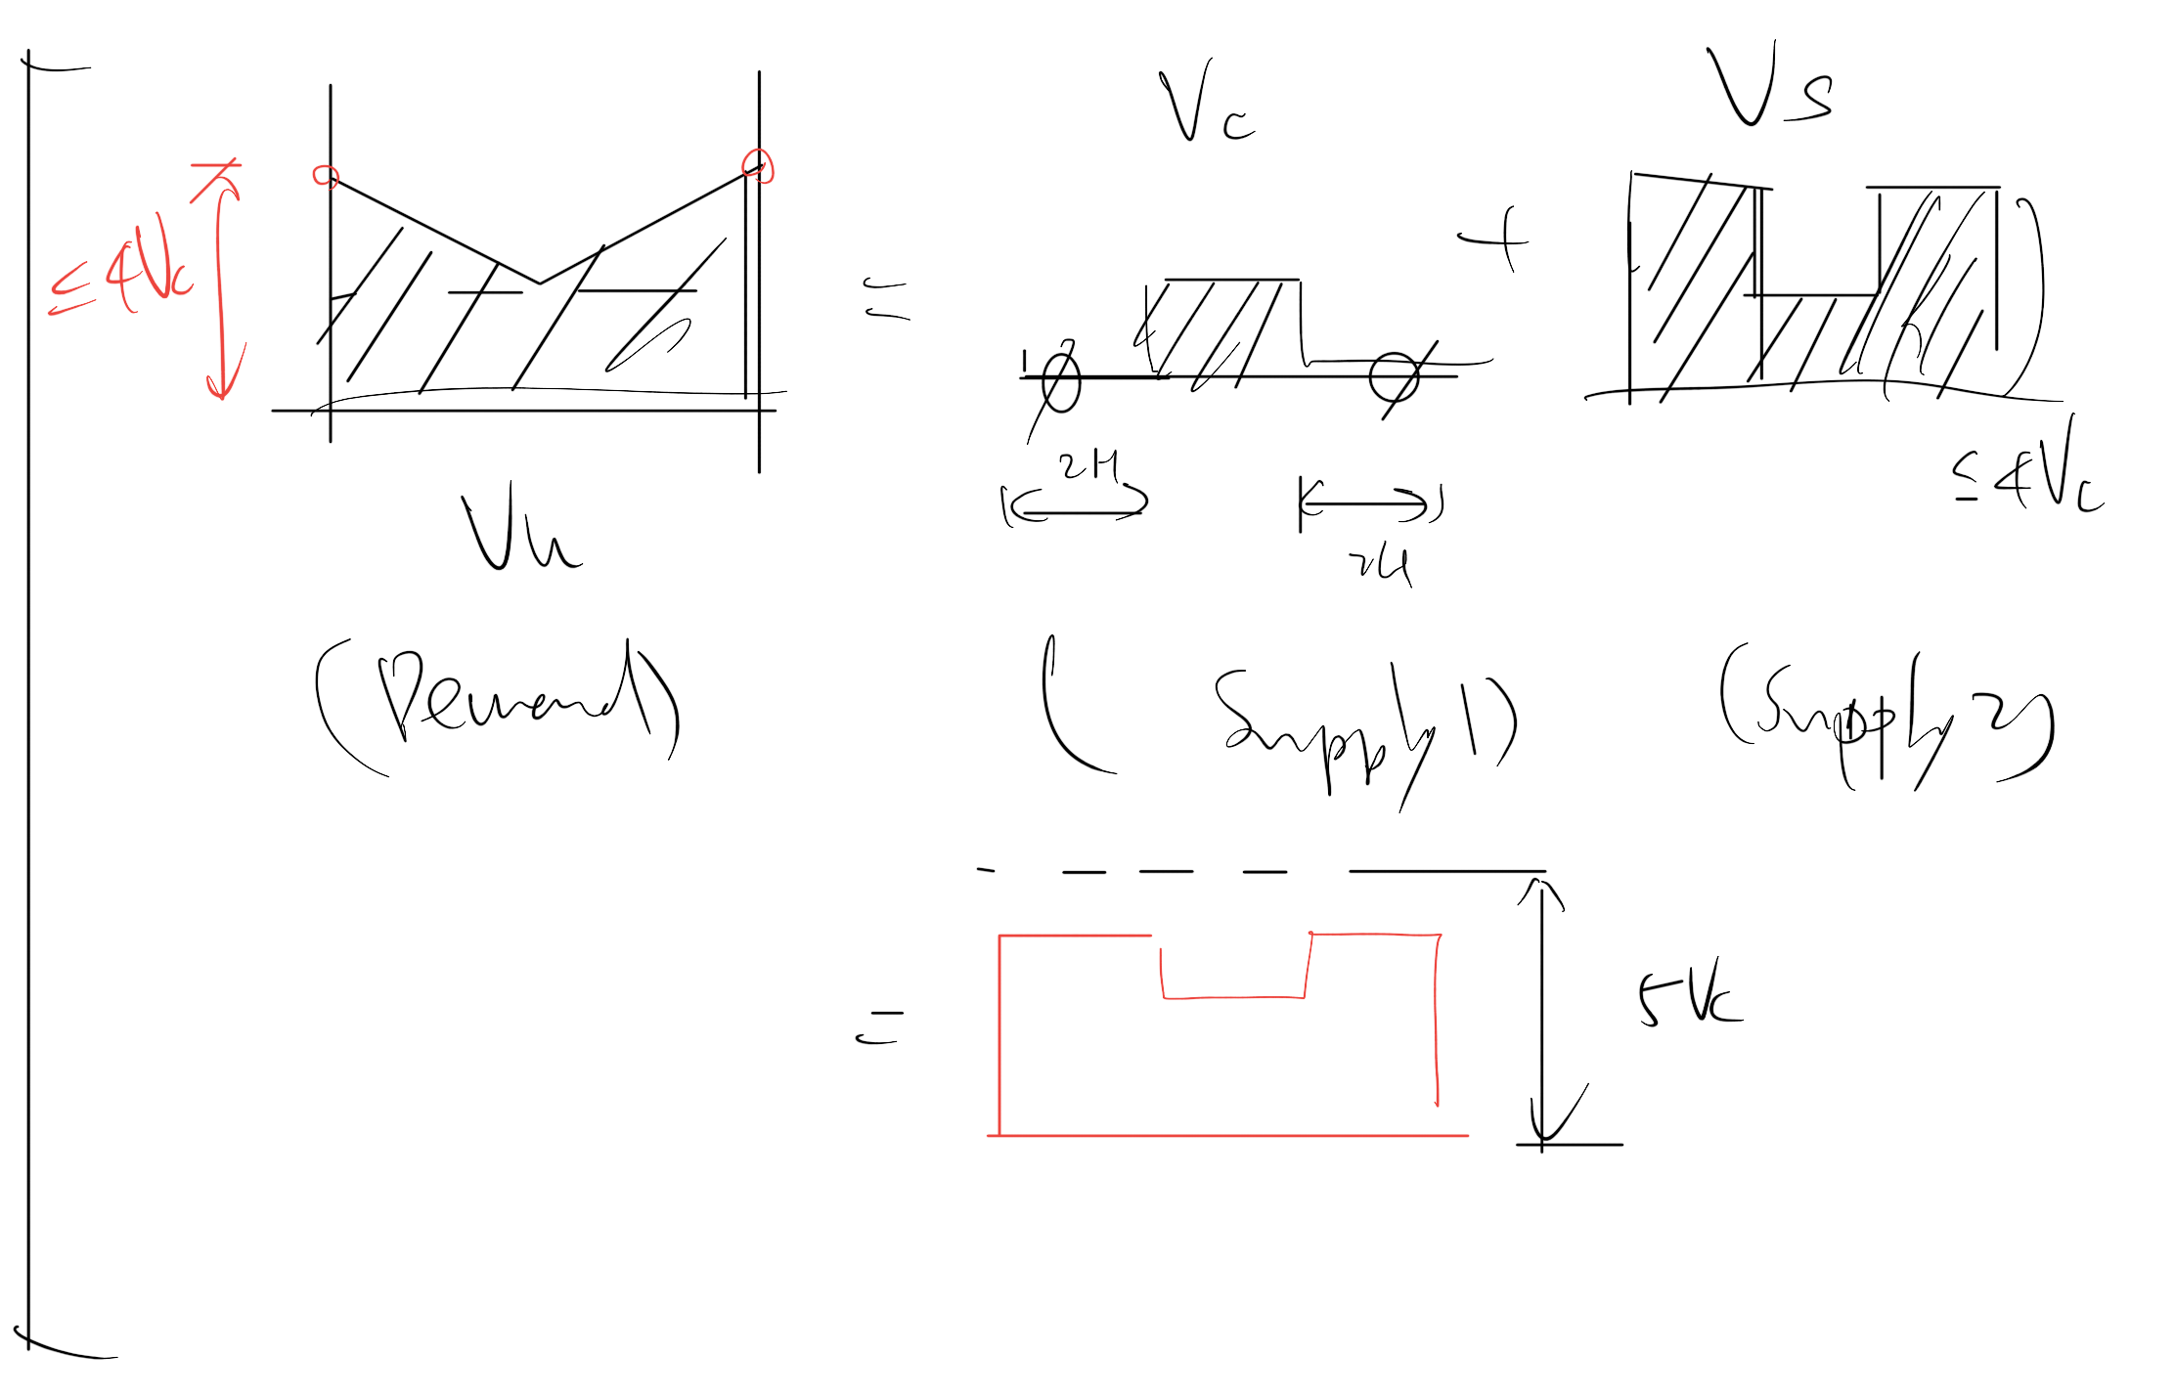

Slide 36
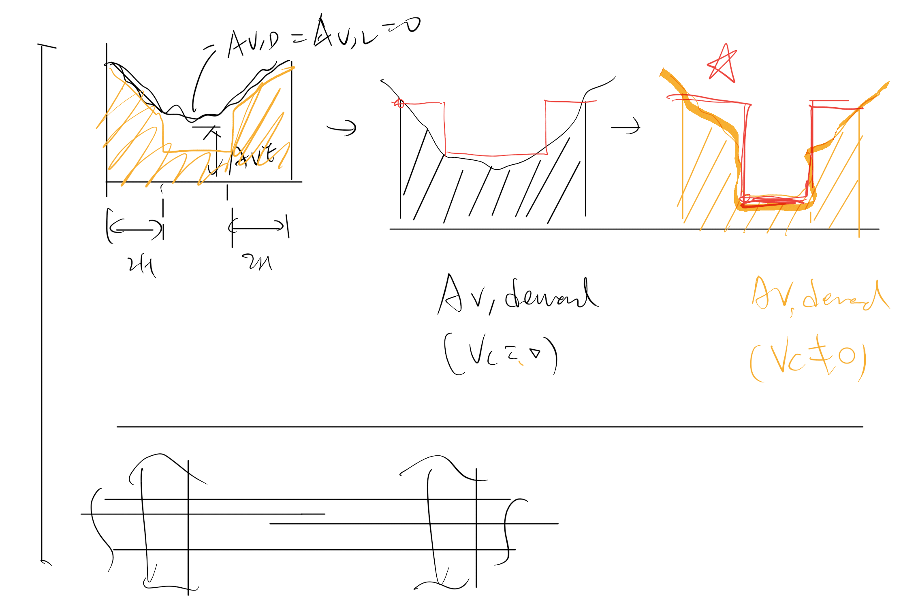

Slide 37
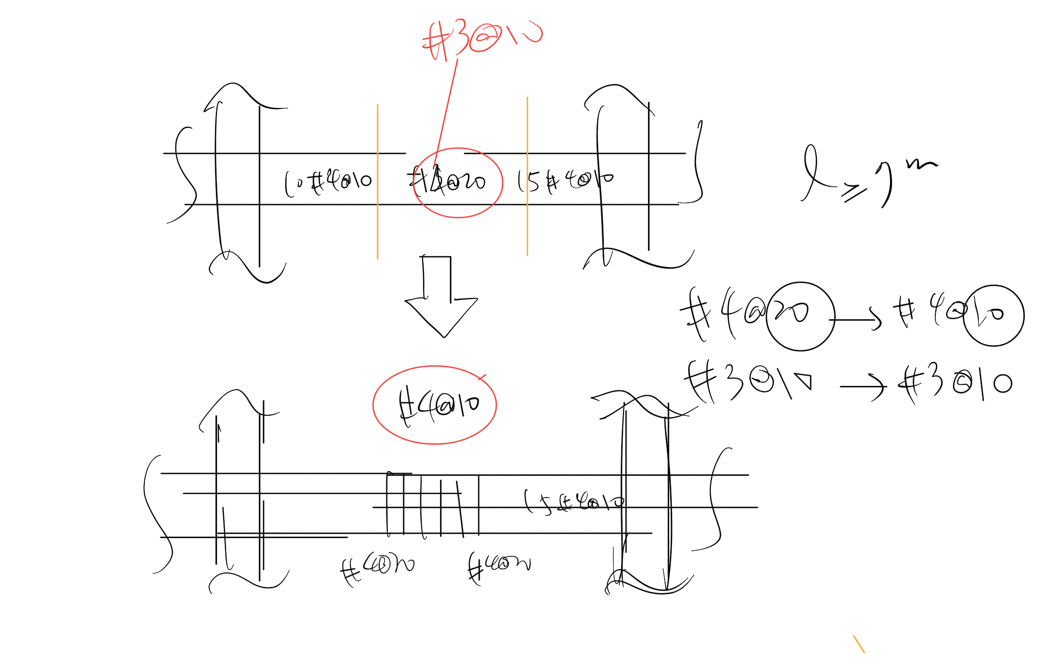

Slide 40
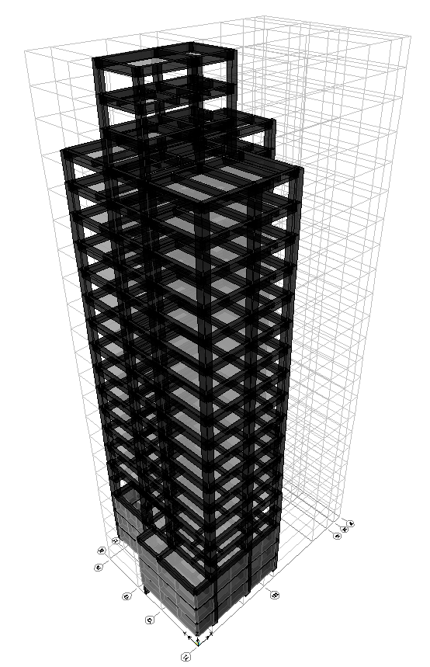
台北住宅案
101.0%
OVERALL RESULT
14F B3
102.5%
TOP RESULT
99.2%
BOT RESULT
20m
30m
Notes:
由於很複雜，先記得最終的結果
400

Slide 41
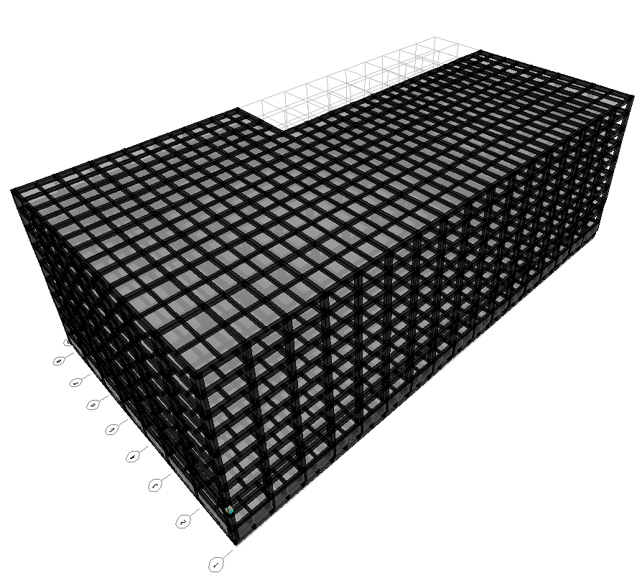
9F B1
93.5%
OVERALL RESULT
92.4%
TOP RESULT
153m
77m
94.7%
BOT RESULT
高雄物流中心
Notes:
3500

Slide 42
BETA VERSION
5 MULTI CUT
TRATIONAL REPLACE?
OVERALL RESULT
101.0%
93.5%
97.8%
93.2%
Notes:
效果不好的地方用傳統斷筋
93.50 => 93.23
101.04 => 97.80
五點斷筋

Slide 44
COST ANALYSIS
REDUCED PERCENTAGE
MATERIAL REDUCED COST
$$Δ=−\frac{60kg}{m^{2}}∗2\%∗\frac{\$28}{kg}=−\$33.6/m^{2}$$
GIRDER USED
MATERIAL COST

Slide 45
COST ANALYSIS
INCREASE
CONSTRUCTION COST
REDUCED
MATERIAL COST
$$Δ=\frac{\$100}{t}∗\frac{0.15t}{m^{2}}−\frac{60kg}{m^{2}}∗2\%∗\frac{\$28}{kg}=−\$18.6/m^{2}$$
$$Δ=\frac{\$200}{t}∗\frac{0.15t}{m^{2}}−\frac{60kg}{m^{2}}∗2\%∗\frac{\$28}{kg}=−\$3.6/m^{2}$$
INCREASE WAGE

Slide 46
COST ANALYSIS
$$Δ=−\frac{60kg}{m^{2}}∗2\%∗\frac{\$28}{kg}=−\$33.6/m^{2}$$
$$Δ=\frac{\$100}{t}∗\frac{0.15t}{m^{2}}−\frac{60kg}{m^{2}}∗2\%∗\frac{\$28}{kg}=−\$18.6/m^{2}$$
$$Δ=\frac{\$200}{t}∗\frac{0.15t}{m^{2}}−\frac{60kg}{m^{2}}∗2\%∗\frac{\$28}{kg}=−\$3.6/m^{2}$$
$$Δ=\frac{\$200}{t}∗\frac{0.15t}{m^{2}}−\frac{60kg}{m^{2}}∗5\%∗\frac{\$28}{kg}=−\$54/m^{2}$$

Slide 47
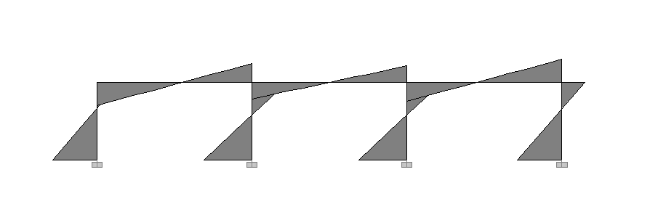
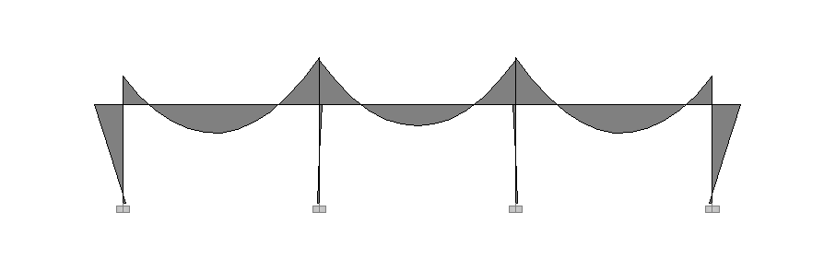
Seismic Load
Moment Diagram
Gravity Load

Slide 48
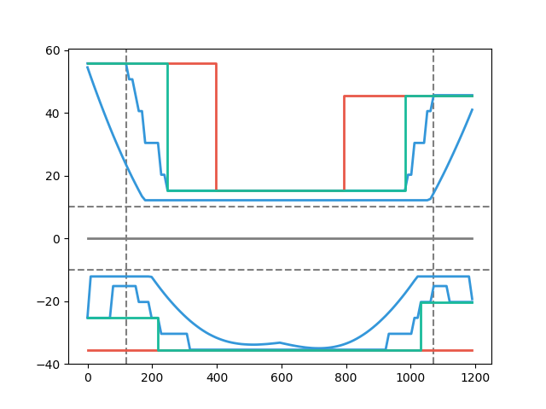
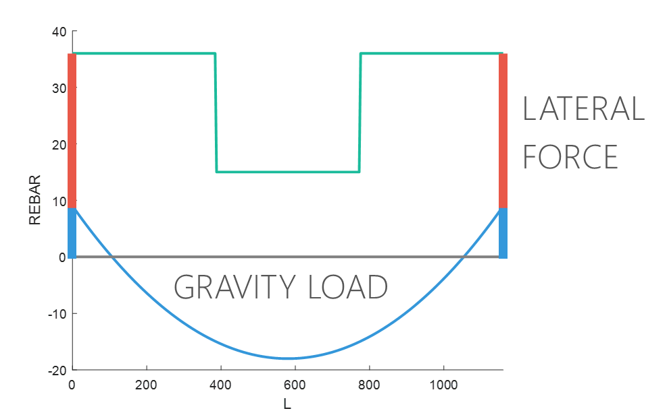
Moment Decay
&
Short Ld
$$\frac{Seismic Load}{Gravity Load}=Small$$
Beam Length
Notes:
下層筋都有可能
梁長影響 Moment Decay & Ld

Slide 49
11 Models
+
Notes:
27=>11

Slide 50
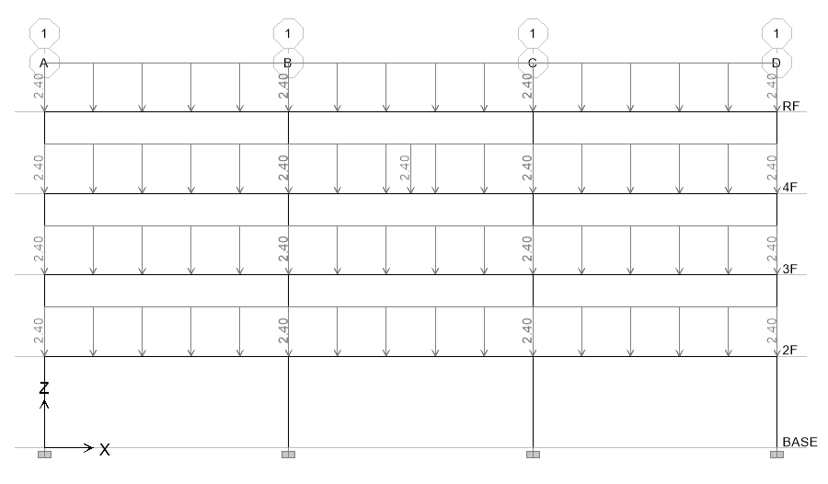
Model Assume
Notes:
混凝土強度越高效果越好
重力需考慮樓版

Slide 51
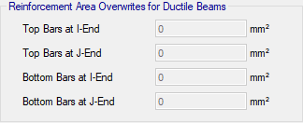
Nonlinear Hinge
Notes:
手做一次模型
開發程式 for etabs 2016
塑絞設定
TEASPA
SERCB
遲滯迴圈

Slide 52
Evaluation
$$\frac{Seismic Load}{Gravity Load}=Small \& Long Span$$
$$\frac{Seismic Load}{Gravity Load}=Large \& Short Span$$
Notes:
大部分是直通筋，不太準

Slide 53
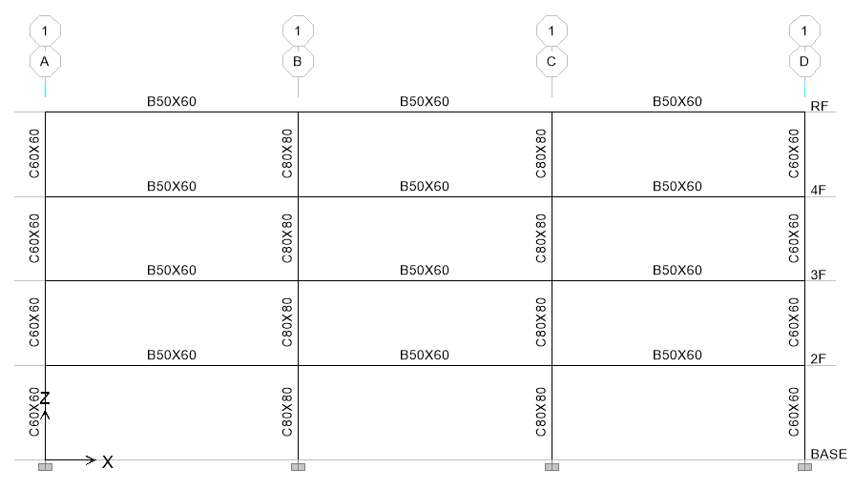
Evaluation
3
47.9s
12 支梁
4
3.9min
5
23.1min
6
2.0hr

Slide 54

Hinge
Third Hinge
+

Slide 55


Hinge
Without Initial Conditions

Slide 56


Pushover Load Pattern
Triangle
Multi-Modes Combination
Modal Pushover Analysis
$$F_{j}=\sum_{n=1}^{N}{Γ_{n}{φ_{n}}_{j}}$$
SRSS
Notes:
定義非線性驗證的邊界

Slide 57


Pushover Result
Hinge
Notes:
比較 Ra, R 值
DBE, MCE 的性能績效點對應到 delta_u
雙線性化找到 delta_y,eff

Slide 58


Pushover Result
耐震性能檢測 PGA
ATC-40

Slide 59

Time history
Story Drift
Scaled to DBE, MCE
DBE < 2%
MCE < 3%

Slide 60


IDA
Limit-State
4% FEMA273
2.5% SEAOC 2000

Slide 62


1D CUT

Slide 63



INPUT
2 MILLIONS
10 MILLIONS
30 THOUSANDS
GEOMETRY
MATERIAL
SECTION
BEAM FORCE
0.5 => 0.1
E2K
DESIGN REBAR
- ACI 318-05

Slide 64
GRAPH
REBAR SIZE & NUM
REBAR LENGTH
STIRRUP SIZE & S
B & D & L
SUPPORT WIDTH
STIRRUP_REBAR = ['#4', '2#4', '2#5', '2#6']
STIRRUP_SPACING = [10, 12, 15, 18, 20, 25, 30]
first calc SIZE & S
groupby a beam
while spacing < MIN_SPACING
UPGRADE SIZE
MERGE
x <= $1/4$
$1/4$ <= x <= $3/4$
x => $3/4$
DROP DOUBLE SIZE

Slide 65

GRAPH
REBAR SIZE & NUM
REBAR LENGTH
STIRRUP SIZE & S
B & D & L
SUPPORT WIDTH
FIRST RUN
first calc SIZE & NUM
TOP_BAR = ['#7', '#8', '#10']
DB_SPACING = 1.5
groupby a beam
while num > 2 * capacity
UPGRADE SIZE
CONSERVATIVE MERGE
x <= $1/3$
$1/4$ <= x <= $3/4$
x => $3/4$
Calc Ld
OPTIMIZATION ALGORITHM

Slide 66
一台梁
SAME SIZE

Slide 67
GRAPH
REBAR SIZE & NUM
REBAR LENGTH
STIRRUP SIZE & S
B & D & L
SUPPORT WIDTH
FIRST RUN
SECOND RUN
first calc SIZE & NUM
groupby 一台梁
while any size < max size
calc max SIZE & NUM
groupby a beam
while num > 2 * capacity
UPGRADE SIZE
Calc Ld
CONSERVATIVE MERGE
x <= $1/3$
$1/4$ <= x <= $3/4$
x => $3/4$
OPTIMIZATION ALGORITHM
Calc Ld
OPTIMIZATION ALGORITHM

Slide 68

GRAPH
REBAR SIZE & NUM
REBAR LENGTH
STIRRUP SIZE & S
B & D & L
SUPPORT WIDTH
POINT COORDINATES
$(x_{2}−x_{1}, y_{2}−y_{1})$
CONCRETE SECTIONS
MIN
梁長 - MAX

Slide 69

THE OTHER CASE
NORMAL GRAVITY LOAD
TOO CONSERVATIVE
MORE THAN INITIAL REBAR
➔
➔
➔
➔

Slide 70
THE OTHER CASE
MAX
➔
MAX
MAX
1/3
2/3
1/4
3/4
1/4
3/4

Slide 71
GENERAL DEVELOPMENT LENGTH EQUATION
DEVELOPMENT LENGTH
MIN
➔
SIMPLIFIED PROVISIONS
Beam width, cover, Fy, Fyt, Fc’,
Rebar‘s Db, Stirrup’s Db,
Spacing, rebar number

